Slide 1






Mentorship Program
News
Aggregation
Khuat Bao Nguyen

Slide 2




Agenda
01
03
Requirement Analysis
Database
02
Mock Up
MentMorship program

Slide 3
REQUIREMENT
ANALYSIS

Slide 4
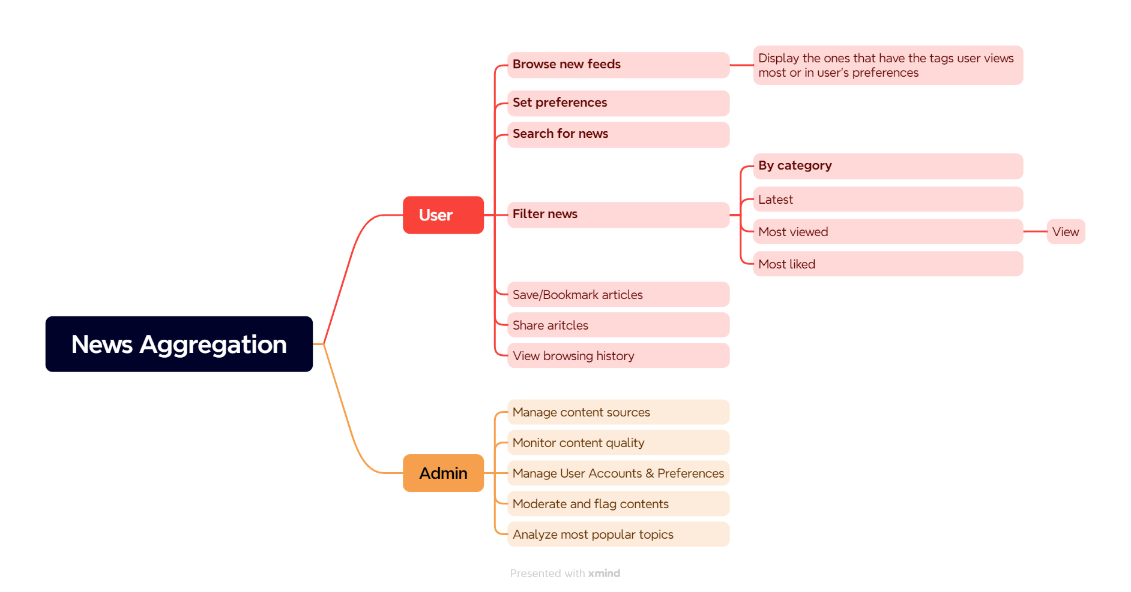
Use Cases

Slide 5
Mock Up

Slide 6
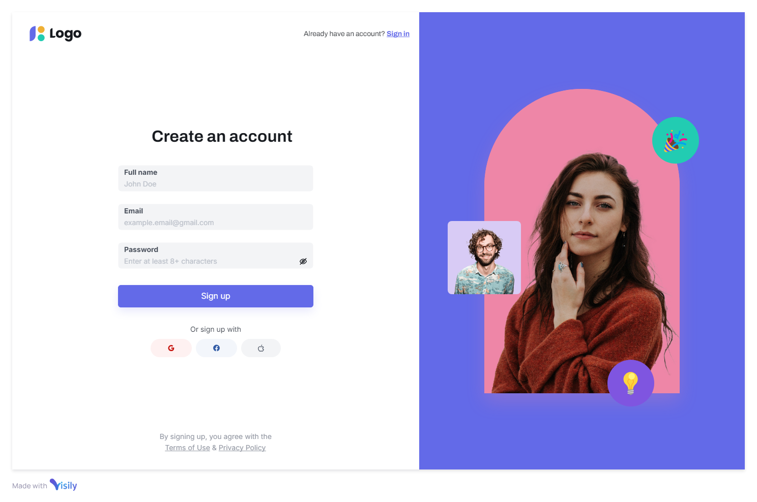
Sign In/Sign Up

Slide 7
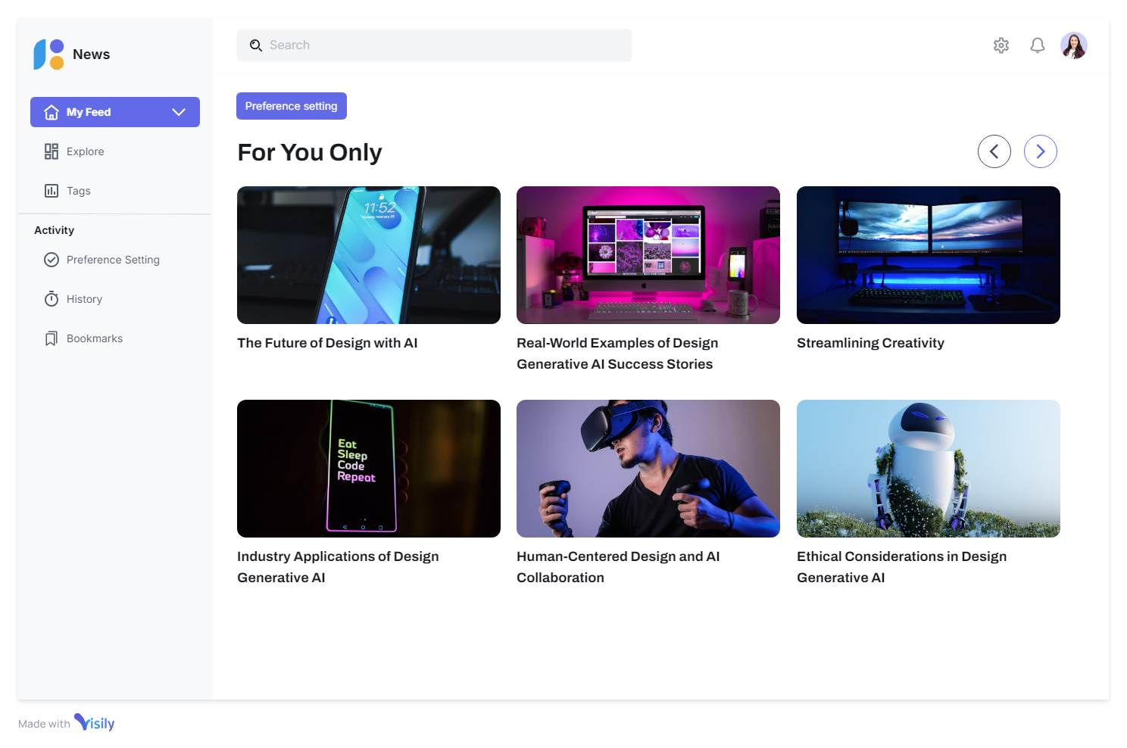
My Feed

Slide 8
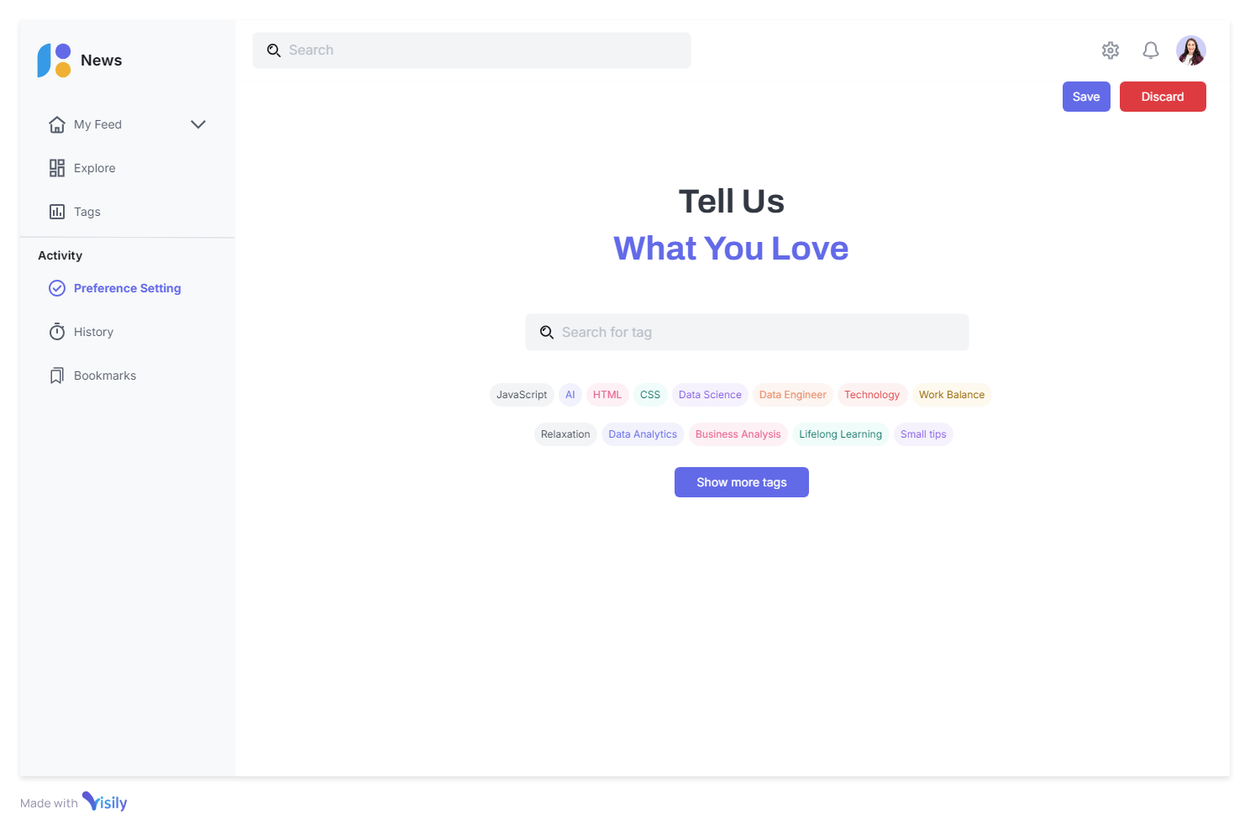
Preference Setting

Slide 9
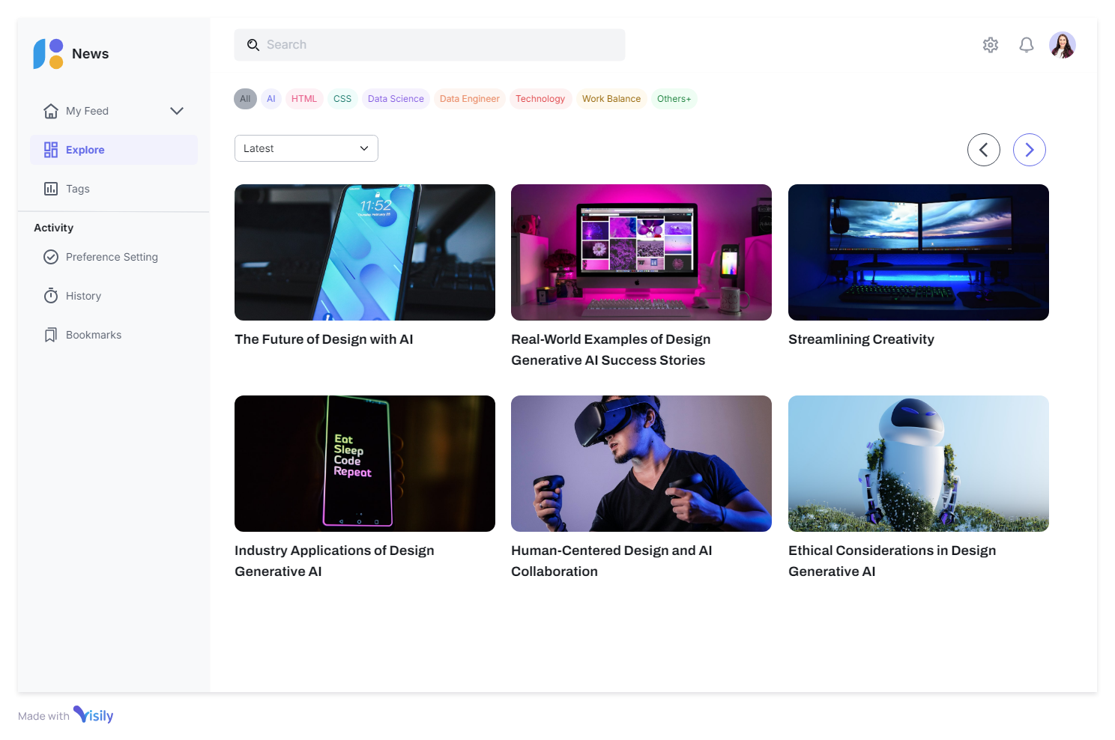
Explore

Slide 10
Database

Slide 11
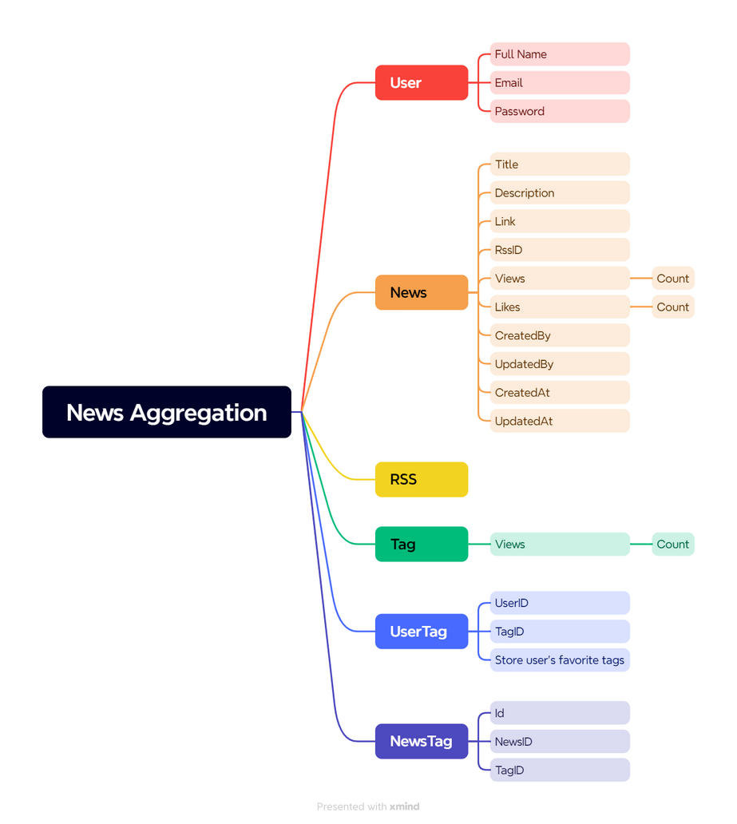
Brainstorm

Slide 12
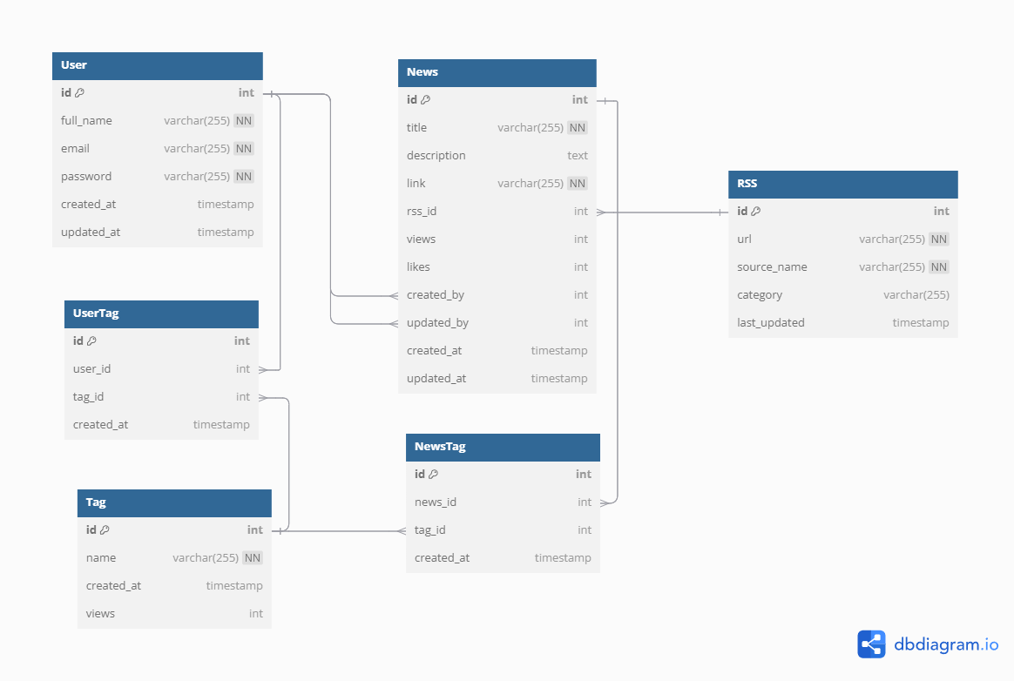
Database

Slide 13
TO BE CONTINUED

Slide 14


Thank you
I really appreciate your time.
Mentorship Program

